Slide 1
Chapter 5
Routing

Slide 2
Introduction
Routing and forwarding is what internet is all about
Routing is the need to react dynamically to changes in the network- when a link or router fails, we need to update all of the routing table across the whole network.
Changes are desirable when failures are repaired or when links and nodes are added. It is possible to conceive of a system of alarms and trouble tickets that are sent to a central location which builds new routing tables and sends them out to the routers, but this would be cumbersome and prone to exactly the failures we need to handle. Instead, we rely on routing protocols to collate and distribute information and network connectivity.
The Routing Information Protocol (RIP) is simple and ubiquitous. The Open Shortest Path First (OPSF) protocol is very popular and has a close rival, Intermediate System to Intermediate System (IS-IS), that performs a similar function. The Border Gateway Protocol (BGP) is important for hooking together the many Service Providers into a single Internet.

Slide 3
Routing and Forwarding
This section describes Classless Inter Domain Routing (CIDR), a simple idea that has made routing more scalable and granular at the same time. It explains how networks and the Internet are broken up into administratively distinct segments called autonomous systems.

Slide 4
Classless Inter-Domain Routing (CIDR)
For example: Class B address has the most significant bits set to 10, with the high order 16 bits to designate the network and the low order 16 bits to identify host. Thus the address 176.19.168.25 is a Class B address for the host 168.25 in network 176.19
When a router had an IP datagram to forward, it examined the destination address and determined its class. It then applied appropriate mask to determine the network to which destination host belonged, and looked that network up in its routing table.
Assigning range of address could have significantly improved the situation, but the subnetting process goes one step further by defining the address range assisted to a subnetwork according to the prefix length. The prefix length can now be any value from 8, for a Class A address up to 30, for the smallest subnetwork.
Routing using subnetwork addresses is not quite as simple as routing using class addresses, because the knowledge of the network mask( prefix length) is not encoded to the address itself. The destination address of a packet must be compared against entries in the table until a match is made. This is classless routing, and since we are forwarding packets between subnetworks or management domains, it is termed Classless Inter-Domain Routing (CIDR).
2²² 30-bit prefix subnetworks within a single Class A network, there are a possible 128 Class A networks. The solution within the internet is to route at an appropriate level of granularity through address aggregation.

Slide 5
Table : Route Aggregation Allows Subnetworks to be Represented by a Sing Routing Table Entry Within the Network.
Subnetwork | Subnetwork Mask | Address Range
172.19.168.16/28 | 255.255.255.240 | 172.19.168.16-172.19.168.31
172.19.168.32/28 | 255.255.255.240 | 172.19.168.31-172.19.168.47
172.19.168.32/27 | 255.255.255.224 | 172.19.168.16-172.19.168.47
The above table suggests that subnetworks that can easily be aggregated should be accessed through the same router. The assignment of subnetwork addresses within a large network becomes a hierarchical distribution problem .

Slide 6
Autonomous Systems
Each organizational grouping of computers defines itself as an autonomous system (AS), that is, a system that can operate in isolation from all other groupings
These autonomous system border routers (ASBRs) are responsible for leaking routing information from one AS to another. Obviously, they don’t want to disclose too much information about the internals of AS because that might reveal just how frail the ISP’s infrastructure is; on the other hand, they must supply enough information to allow IP packets to be routed to the hosts AS supports.
In a simple hierarchical AS model, the relationship of routers within the AS to ASBR is similar to the relationship between hosts on a multi-access network to their router.

Slide 7
Building and Using a Routing Table
A router only has to answer a very simple question- given an IP datagram carrying a specific destination host address, out of which interface should the datagram be sent, and to which next hop? Note that the second half of this question is really necessary only on interfaces that lead to multi-access links where the data-link layer is called on to deliver the datagram to the correct next hop router.
A routing table, therefore, is some form of look-up algorithm that takes an IP address and derives interface identifier and a next hop IP address.
First, the routing table is in some sense an ordered list. That is, when the table is searched for a particular address there may be several entries that match the address, but only one of the entries can be chosen and used for any one pocket. The most obvious example is a router that has two routes, both of which provide a match for the destination address. The usual solution is to search for the route that matches the longest prefix from the destination address- the explicit route to the directly attached host matches all 32 bits and is selected in preference to the default route which has a netmask 0f 0.0.0.0 or a prefix match of zero bits.
Clearly it is advantageous to arrange the table so that it can be searched most efficiently by IP address. This sort of problem is a delight to mathematics, and an array of solutions have been developed. The most common solution is the Patricia Tree, which combines the concepts of best match with binary ordering to solve both requirements at once.

Slide 8
Building and Using a Routing Table
Construction of a routing table within a router becomes an issue of taking information from all the sources (manual configuration, IGPs and EGPs) and populating this whatever structure is used to supply efficient storage and lookup. Updating this table from the routing information is supplied to a router in neither a quick nor a trivial process.
Routing table looks-up times can be reduced using a route cache. This is simply a smaller copy of the routing table that stores most recently used routes from the main routing table. Route caches are particularly suitable for use on distributed forwarding processors in a multiprocessor system but care must be taken not to cache only a generic route when more specific routes also exist- because this might lead to misrouting. Also, that in very busy routers that see a lot of traffic for many destinations, caches may not work very well because they quickly grow to be as large as the main routing table. All of the acceptable routes from the routing protocols are combined with configured static routes and discovered direct route into one large assemblage of information, the routing information base (RIB).
Some of the information may suggest multiple routes to a single destination and a routing decision engine applies routing policies to determine the best routes. The processing required to determine the best route depends on how the information was gathered and what the definition ‘best’ is.
The output of the routing decision engine is the forwarding information base (FIB). The FIB gives unambiguous instructions to the component of the router that forwards data packets. Given a destination address, the FIB will tell the router interface to forward the packet and what the address of the next hop is. The Fib contains the definitive best routes according to the local routing decision policies, and the router needs to share this information with the other routers in the network to which it belongs. When we talk about the routing table or issue a command to show the routes present in the router, we are really examining the Routing Information Base RIB.

Slide 9
Building and Using a Routing Table
The internals of a router showing the distinction between the routing information base and the forwarding information base

Slide 10
Router IDs, Numbered Links and Unnumbered links
The link between the two routers is called numbered link because IP addresses(Numbers) have been assigned to it. Router X has now two addresses, 172.168.25.4 and 172.168.25.25, both of which identify the router, but which also provides more specific routing information since they also identify links. Generically the router ID, does not need to be routable, but must be unique within the network if it is to be used successfully to identify a single router.

Slide 11
Distributing Router Information
Consider the network in the figure below
The routing tables for simple networks can be manually configured with ease.

Slide 12
Distance Vectors
The simplest and most intuitive way to distribute network information also makes the construction of routing tables particularly easy are called distance vector protocols. Sometimes called routing by rumor, the basic premise is that the routers chatter to each other, exchanging all the information about the routes through the network that they know about , and so distributing, in time all of the best paths.

Slide 13
Distance Vectors
The network of routers in the figure can be used to illustrate how this works.

Slide 14
Distance Vectors
Router A would send a message down each of its attached links saying, “I am here and I am directly attached to this link”. It does not know what or who is at the other end of the link, but that doesn’t worry it. The receivers of the message now all know that if they have any message for router A they can send it down the link on which they received the message. This forms an entry in the routing table; so for example, Router B would have a single entry in its table that says, “Send to Router A out of interface 10.0.1.2.”
Now when each router receives this fragment of routing information from Router A, it passes the information on to everyone it knows. So. For example, Router C hears from Router A and tells Router B and D, “I am here and I am directly connected to you. Also, I am one hop away from Router A.” Now Router B knows how to reach Router C and also knows two ways to reach Router A. which should it install in its routing table? Well, it simply looks at how far away Router A is on each of the routes- in other words, how many hops would a datagram travel in each case? This is information it knows from the messages it receives and so it can select the optimum route and install it in its routing table.
If for whatever reason, Router B first heard about Router A through Router C (perhaps the link between Routers A and B was down for a while), Router B would install in its routing table a route to Router A through Router C and would advertise this information to Router E: “I am here and I am directly connected to you. Also, I am one hop away from Router D , two hops away from Router C and two hops away from Router A.”

Slide 15
Distance Vectors
But Router E may already have heard from Router F: “I am here and I am directly connected to you. Also, I am one hop away from Router D, two hops away from Router C and two hops away from Router A”. The new information about a path to Router A is not interesting to it – it is the same distance (three) as a route it already knows about- but the new paths to Router B and C are better than those it previously had, so it installs them in its routing table and informs Router F, “I am here and I am directly connected to you. Also, I am one hop away from Router B, two hops away from Router C and three hops away from Router A”. Router F knows it can reach Router C in just two hops on a different route, so it discards this new route, but would still pass on the information about the connectivity to Routers E and B.
If the link between Routers A and B is restored, Router B becomes aware of a better route to Router A. Router B updates its routing table and informs its neighbors about the new route. Router C is not interested because it is, itself, just one hop away from Router A, but for Router E the new route is an improvement, and it updates its routing table and passes the information on. Router F is not impressed since it already has two-hop route to Router A and so it discards the new information.
After the routing information has converged, the network is stable and all routers can successfully forward data. But suppose there is network error- the link between Routers B and C fails and the failure is detected by Router B. Obviously, Router B can retire any routes that use that link, although it has no alternatives, but it must immediately stop advertising those routes to its neighbors.

Slide 16
Distance Vectors
After route withdrawals, routing tables can become repopulated if each of the routers re-advertises its routing table. As the withdrawal ripples outwards from the failure, so new routers spread inwards. In distance vector routing, every router runs a timer and periodically re-advertises all of its routing information – this can fill in the gaps left by the withdrawn route. So, for example, after a failure of the link between Routers B and E, when its re-advertisement timer pops, Router D would re-advertise, “I am here and I am directly connected to you. . Also, I am one hop away from Routers A and C, two hops away from Router B.”
The alternative is to allow triggered updates, so that whenever a router detects any change in its routing table it immediately re-advertises the entire routing table. The same number of exchange is needed to repair the routing tables, but the time taken is much shorter. Note that one consequence of triggered updates is that distance vector protocols are very chatty immediately after a failure as they spread the rumor of the problem.
To effect this, each router runs a timer for each route in its routing table and if, the timer expires, it treats that event as a route withdrawal or link failure, marking the route unavailable and immediately passing on the rumor. This process is far from ideal since the timer must be large enough not to over react to occasional packet loss (that is, lost advertisements) and must take account of how frequently ( or infrequently ) the routers perform the background re-advertisement – it can take quite a while for a distance vector routing protocol to notice a network problem.

Slide 17
Distance Vectors
Figure : In even a simple topology, a distance vector routing protocol may exchange redundant routes, counting to infinity.
A classic problem with distance vector routing protocols is shown in the figure.

Slide 18
Distance Vectors
In steps 1 through 4 the simple network topology is exchanged and the routers build their routing tables, but at step 5 Router A fails and Router B withdraws its route to Router B. at the same time, Router C still knows of a route to Router A and advertises that it is two hops away (step 6). “Great”, thinks Router B, “there is a new route to Router A”, and it advertises it (step 7). Router C gets this advertisement and replaces the route that it had (same interface, same next hop and re-advertises (step 8) a five-hop route. The process continues, with the hop count increasing towards infinity. This problem is referred to as counting to infinity.
The solution to the problem of counting to infinity is to operate a split horizon. A horizon defines the range of an observer’s perception, and in a distance vector routing protocol it is used to limit the visibility of one router into another router’s routing table. This is usually implemented by a simple rule that says that no router may advertise out of an interface a route that it learned through the interface. This completely solves the problem as expressed in the example.
An even more effective measure is for a router to explicitly disqualify a route back along the interface on which it learned the route. In poison reverse split horizon , Router C would advertise “Reach {C, 1 hop}, Can’t reach A or B, at step 6. this variant makes sure that routing tables are explicitly flushed of bad routes.

Slide 19
Distance Vectors
This is not much more complex than the network figure(slide 17), but when router A fails a counting loop is built between the other three routers and the hop count continues to increase towards infinity. There is a simple solution to this: the distance vector protocol stops counting hops and circulating routes when the count reached a predefined threshold. At this point, the destination is flagged as unreachable and advertised accordingly, which puts the routing tables right.
Distance vectors routing protocols may combine the concept of a counting threshold and an unreachable flag by designating a specific hop count value to be effectively infinity. There is an issue with how quickly all of the routers in the network can discover changes in the network such as router failures. The redefinition of infinity to a finite number limits the size of the distance vector network because at a certain point a long route will be declared as unreachable.

Slide 20
Distance Vectors
Figure: counting to infinity until the route is declared unreachable at a threshold of N hops.
RCF 1058, which defines the Routing Information Protocol (a distance vector protocol), also provides a good introduction to distance vector routing.

Slide 21
Link State Routing
Link state routing does not distribute any routes, but exchanges topology information that describes the network. Each node is responsible for advertising the details of the links it supports, and for passing on similar information that it receives from other routers. In this way each router in the network builds up a complete database of the available links and which nodes they interconnect. In effect, each router has a full identical map of the network. This process is necessarily more complex because the router must start from the link state database rather than simply compare routes that it receives from other routers.
In state link routing there is a close bond between neighboring routers; they need to become peers to establish a peer relationship for the purpose of exchanging link state information. This first step is achieved through a Hello Protocol in which each router sends a Hello message on each link to introduce itself to its neighbors. The format and precise content of the Hello message is of course dependent on the link state routing protocol in use , but it must uniquely identify the link on which the message was sent (using an IP address) and the router that sent the message (using a network-unique router ID). The receiver of a hello message responds with its own Hello so that the routers both know about each other.
The Hello Protocol is also useful to monitor the liveliness of the links between the routers. The Hello message is periodically retransmitted by both routers and if a router does not hear from its neighbor for a number of retransmission periods it declares the link to have failed.

Slide 22
Link State Routing
The first thing that peers do is synchronize their link state databases by exchanging messages that report on each link that they know about. If the router has already received information from other routers the synchronization will include information about other links within the network. The information about each link is sent as a link state advertisement (LSA) or link state packet (LSP) which is formatted and built into a message according to the rules of the specific routing protocol.
In this way two routers that become peers rapidly reach a position of having identical link state databases; that is, they both know about the same list of links within the network. From then on, whenever one of the routers learns about a new link from another of its peers, it floods this information to its new peer. The flooding process is simple: the router receives an LSA and searches its link state database to determine whether it already knows about the link; if it does it discards the new LSA, but if it does not it adds the link to its database and sends the new LSA out of each of its interfaces except the interface on which the LSA was originally received (there being no point in telling the news to the router that already knows it ).
Once an LSA has been distributed and the link is established in the link state databases of the routers in the network, the link can be considered in the path computations that operate on the link state database. This means that if the link fails, it must be withdrawn from the network. Link failure can be detected at a hardware level, at the data-link layer, or by failure of Hello protocol.

Slide 23
Link State Routing
The solution applied by link state routing is to put an age limit on all information advertised by an LSA and to withdraw that information when the LSA times out. LSA aging creates its own problems because the routers must now take action to keep their link state databases from emptying. This is achieved by periodically refreshing (flooding) the contents of the link state database of one router to its peers. Since a batch refresh would probably clog the network, individual timers are maintained for each LSA.
One final operational point in link state routing is that the routers must be able to distinguish between LSAs that refer to the same link. Since the LSAs can arrive along different paths through the network, it is important to be able to sequence them to determine whether the link went down and then came up or vice versa. Time stamps don’t help because the originating router might reset its clock at any moment so simple sequence numbers are used. Various counting schemes are used in the link state routing protocols to generate LSA sequence numbers and to handle the fact that LSAs may persist in the network for a long time.

Slide 24
Link State Routing
These counting issues are resolved in some link state routing protocols by using a lollipop-shaped sequence number space. When a router restarts it begins counting at a well known origin value (n). The sequence numbers increment linearly until they reach the start of a counting loop(m). Once on the loop, counting continues incrementally, but resets back to the loop starting value when the maximum is reached (x). OSFP, a link state protocol described in section 5.5, uses negative numbers for the stick of the lollipop and positive numbers for the head of the lollipop. This means that counting starts at n= 0x80000001 and increases through 0x80000002 until it reaches x = 7fffffff. The next value wraps the counter back to m=0.

Slide 25
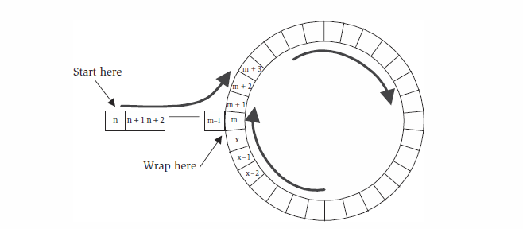
Link State Routing
Lollipop-shaped sequence number counting

Slide 26
Link State Routing
The memory and processing required to handle large link databases are not insignificant. The memory requirements grow linearly with the number of links in the network, but the processing is somewhere between n*log(n) and n² for a network with n links. Additionally, the amount of link state information that must be exchanged in a large network is a cause for concern because it can swamp the links that should be carrying data traffic.
The solution employed in networks is that use link state routing is to group the routers together into areas. Where areas meet they are joined by area border routers (ABRs) and it is here that scaling optimizations are made.

Slide 27
Path Vectors and Policies
Path vector routing is in many ways similar to distance vector routing, but it is considerably enhanced by the inclusion of the entire path in the route advertisements.
A significant advantage of a path vector protocol is that it allows a router to choose a route based not simply on the distance or cost associated with the route, but by examination of the routers and links that comprise the path. For example, policy based routing decisions can be made using local rules based on knowledge of links that are error prone, vulnerable to security attack, or expensive financially- routes that can be chosen or excluded to utilize or avoid specific links.
One serious problem with policy based routing is that each router in the network may apply different policies. Distance vector and link state routing are policy based routing techniques, but they use a simple policy (least cost) and all routes in the network use the same policy - this means that it is possible to predict the behavior of the network and to know the route a datagram will follow in a stable network once it has been launched. It is not hard to see how this pre-dictatibility could be catastrophically broken as soon as the routers apply policies that are either different from each other or simply different from the least cost policy.

Slide 28
Path Vectors and Policies
The biggest problem of a path vector protocol still remains the amount of information that needs to be propagated. There are two aspects to this and two corresponding solutions. First, as the length of the route grows, the size of the path vector also grows and this may become unmanageable. Fortunately, routers outside of an autonomous system (AS) don't need to know or understand the routes within the autonomous system, and so the path across the AS can be advertised as a single step.

Slide 29
Path Vectors and Policies
This route summarization is showed in the following figure:

Slide 30
Path Vectors and Policies
Distance vector and link state protocols that have already been described tend to be used within a single autonomous system and are consequently called Interior Gateway Protocols (IGP) note that one feature of this flexibility is that the ability to hide the internal workings of one AS from the view of another - this proves to be very popular between rival ISPs who don't want to show each other how they have built their networks.

Slide 31
Open Shortest Path First (OSPF)
Open Shortest Path First (OSPF) is a link state, interior gateway protocol developed by the IETF with a good look over the fence at IS-IS. We are now at version two of OSPF, version one having lasted only two years from its publication as an RFC, to tis eclipse by the RFC for OSPFv2.

Slide 32
Basic Messages and Formats
OSPF messages are carried as the payload of IP datagrams using the protocol identifier value 89 (0x59) in the next protocol field in the IP header. All OSPF messages begin with a common message header. The version identifier shows that this is OSPF version two, and the message type indicates what the body of the message is used for.
Table : OSPF Message Types
Type | Message
1 | Hello. Used to discover neighbors and to maintain a relationship with them.
2 | Database Description. Lists the link state information available without actually supplying it.
3 | Link state request. Requests one or more specific pieces of link state information.
4 | Link state Update. The primary message in OSPF – used to distribute link state information
5 | Link State acknowledgement. Acknowledges the safe receipt of link state information.

Slide 33
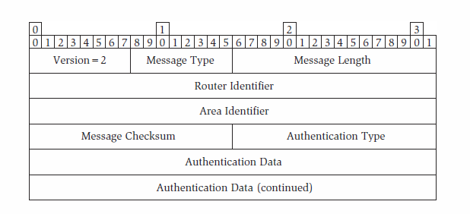
Basic Messages and Formats
Figure: The OSPF common message header.
The Router Identifier field provides a unique identifier of the router within the autonomous system to which it belongs. Note two points:
It is not sufficient for the OSPF router identifier to be unique within the area to which the router belongs.
The router identifier may be set to be one of the IP addresses of the router. The router identifier may be set as any unique 32-bit number and is not necessarily a routable address.

Slide 34
Basic Messages and Formats
The next field gives an are identifier for the area to which the router belongs. The message checksum is a standard checksum applied to the whole of the OSPF message – it is not computed and set to zero if cryptographic authentication is used.
The authentication type field indicates what authentication is in use for the message. An OSFP router is configured to use only one type of authentication on each interface and should discard any OSFP messages it receives that use any other type of authentication.
Null authentication (type zero) does not apply any additional safeguards to the messages and requires that the message checksum is used. Password authentication (type 1) does not provide additional security since an 8-byte (null padded) password is transported “in the clear” in the Authentication Data field of each message, but it does offer a degree of protection against misconfiguration or accidental misconnection of routers that would otherwise discover each other and distribute OSPF link state information. Cryptographic authentication (type 2) uses the MD5 algorithm to ensure that the data delivered in unchanged from the data that was sent and so to validate that it arrived from the real sender.

Slide 35
Neighbor Discovery
The first job of an OSPF router is to discover its neighbors. It uses a Hello exchange as described in Section 5.2.2 to establish an adjacency with each of its OSPF peers, and the Hello message continues to be used to keep these adjacencies alive. In OSPF, a fair amount of parameter negotiation is also carried out. The Hello message begins with the common message header.
The Network Mask field gives the router’s opinion of the network mask that applies to the network on which the message was issued. The Hello Interval states how often in seconds the router will retransmit a Hello message to keep the adjacency alive, and the Router Dead Interval says how long this router will wait without hearing from its neighbor before declaring the neighbor dead.

Slide 36
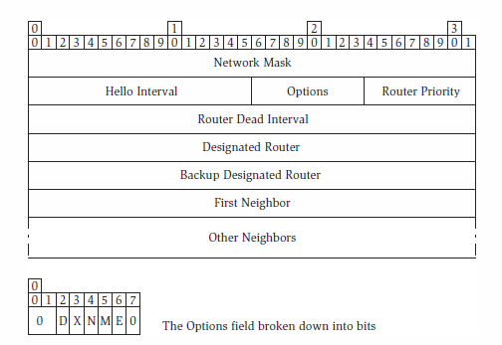
Neighbor Discovery
Figure : The OSPF Hello message.

Slide 37
Neighbor Discovery
Table : The OSPF Router Option Flags
Flag | Meaning
D | If set to 1, this router intends to treat this interface as a demand circuit, that is, one for which traffic is charged by the byte and where reducing traffic is, therefore, important. On a demand circuit link, OSPF does not retransmit Hello messages but relies on the data-link layer to report network failures. Similarly, OSPF does not retransmit link state advertisements on demand circuits in stable networks, and the link state database information must be prevented from timing out.
X | If set to 1, the router is willing to receive and handle link state advertisements that carry private data for autonomous systems.
N | If set to 1, the router is willing to receive and handle link state advertisements that describe Not So Stubby Areas (NSSAs).
M | If set to 1, this router will forward IP multicast datagrams and can handle group membership advertisements.
E | If set to 1, the router is willing to receive and handle link state advertisements that pertain to external links, that is links that connect this autonomous system to another

Slide 38
Neighbor Discovery
The Options byte can be broken down into separate bit flags, described in the Table. These bits indicate the capabilities of the router and its willingness to participate in certain subsets of OSPF function.
The Router Priority byte indicates the router’s willingness (or desire) to be a designated router. When there are multiple routers on a multi-access network, the one with the highest priority value becomes the router for the network and is called the designated router. If two routers have the same priority, the one with the numerically larger router ID gets the job. Two fields are dedicated to identifying the designated router and backup designated router if this Hello message is issued on a multi-access link.
The remainder of the Hello message lists all the routers the sender already knows about and with which it has established OSPF adjacencies. The number of routers listed here is governed by the length of the Hello message. Each router is identified by its router ID.
the demand circuit option (the D-flag) is particularly useful on slow links and dial-up links. This mixes the concepts of cost and bandwidth. The original intention of the demand circuit option was to limit the number of bytes sent by the protocol to keep the connection active.

Slide 39
Synchronizing Database State
Having discovered a neighbor and introduced itself, the first job of an OSPF router is to synchronize its link state database with that of its neighbor. In practice, this means that each router must send a copy of its entire database to its new neighbor and both routers must merge the received information with their own databases. This is all well and good when one of the routers has just rebooted and has an entirely empty database, but it is more likely that routers are participating in well-connected networks the databases on the two routers will typically have many entries in common and to exchange them would be a waste of bandwidth.
This situation is improved by the Database Description and Link State Request messages. Instead of sending the full contents of its link state database, a router sends a Database Description message that supplies a list of the available database entries without including the data from the entries. A router that receives a Database Description message can search its own database for the listed entries and use the Link State Request message to request that the other router send it specific link state information that is missing from its database.

Slide 40
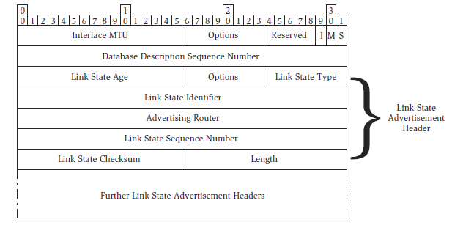
Synchronizing Database State
Figure :The OSPF Database Description message.
The link state database entries are described in the Database Description message using the link state advertisement header—a piece of descriptive control information advertised with the link state information.

Slide 41
Synchronizing Database State
The Database Description message also contains a few additional fields to describe its operation on the link. The Interface MTU describes the size in bytes of the largest MTU the router can send on this interface—larger datagrams will require fragmentation. The Options reflect the router’s capabilities and intentions and are as described
The Database Description message contains a Database Description Sequence Number to sequence a series of Database Description messages if all the information cannot fit into a single message. The initial Database Description message is sent with the I-bit set, and each message has the M-bit set to show whether or not more Database Description messages will follow.
The S-bit in the Database Description message is used to define the slave/ master relationship between the routers during the database exchange process. If the bit is clear, the router is the slave. This uneven relationship is used to send and acknowledge Database Description messages. Acknowledgements are important to ensure that the other router knows about the whole of a sending router’s database. A Database Description message is sent with the M-bit set and is acknowledged by simply turning the message around with the M-bit clear. If a router decides that it wants to see a piece of link state information listed in a Database Description message, it sends a Link State Request message.

Slide 42
Advertising Link State
The job of OSPF is to advertise information from one router to another. The routers need to know about routers, links, and networks. It may also be necessary for them to communicate about links to ASBRs (the routers that sit on the boundary to other autonomous systems), about links out of this AS, and about multicast capabilities.
Each piece of this information is carried by OSPF in a Link State Advertisement (LSA) and each LSA is represented by an entry in OSPF’s Link State Database. An OSPF router advertises LSAs to its neighbors using the Link State Update message. Each Link State Update message may carry more than one LSA, as indicated by the 32-bit count field.
Each LSA is made up of a standard header and advertisement-specific data.

Slide 43
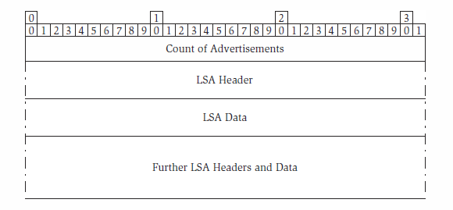
Advertising Link State
Figure: An OSPF Link State Update message contains a sequence of link state advertisements, each constructed as a header followed by LSA data.

Slide 44
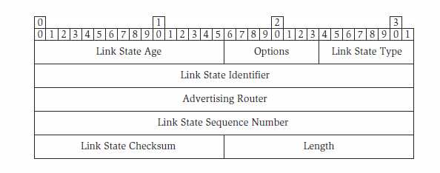
Advertising Link State
Figure: The OSPF Link State Advertisement header.
the LSA header contains three fields to uniquely identify the piece of link state information: The Advertising Router provides the router ID of the router that first advertised this piece of information and is not updated as other routers redistribute the LSA around the network; the Link State Identifier uniquely references this piece of link state information within the context of the advertising router; and the Link State Sequence Number makes it possible for the advertising router to update the LSA without having to assign a new link state identifier (note that the sequence numbers are assigned using a lollipop number space starting at 0 × 80000001 and running up to zero on the lollipop stick, and running from zero to 0 × 7fffffff with wrap-back to zero on the head of the lollipop).

Slide 45
Advertising Link State
Table : Timers and Actions Associated with Link State Advertisement in OSPF
Time | Action
1 second | Default amount by which the LS age is incremented for each hop over which the LSA is transmitted.
5 seconds | The shortest interval between LSA updates on the originating router. This protects the network against flapping resources which might cause a very fast rate of LSA generation.
5 minutes | The rate at which a router recomputes the Fletcher checksum on its stored LSAs. This particularly pessimistic feature protects a router against memory overwrites, static electricity, and meteor strikes so that LSAs that are corrupted within the link state database do not get used to compute routes.
15 minutes | If the LS Age on two LSAs with the same sequence number differs by at least this amount, the more recent LSA replaces the old one.
30 minutes | When the age reaches 30 minutes the originating router reissues the LSA with an incremented sequence number. This keeps the LSA alive in all the routers in the network. A small percentage of dither is usually applied to this timer to prevent all LSAs from being refreshed at once, which would cause a burst of traffic in the network.
60 minutes | When an LSA reaches this age it is no longer used for route computation (note that this never happens at the originating router). The LSA is re-advertised to all neighbors and then discarded from the database. The re-advertisement is to ensure that the LSA is also removed from the link state databases on other routers using a rule that says that an LSA received with age 60 minutes is immediately updated in the local database to replace any younger entries. This feature is used by OSPF when an originating router wishes to withdraw a piece of link state information—it simply re-advertises the LSA with the LS Age set to 60 minutes.

Slide 46
Advertising Link State
The Link State Age is used to age out old state from the database. It is set to zero by the originator and grows in seconds in real time while it is stored in a link state database or when it is passed between routers.
The top bit of the LS Age field can be used in conjunction with the demand circuit option to mean that the LSA should not age out of the link state database. when the age reaches 60 minutes (with the top bit set) the LSA remains in the database. The originating LSA uses the same mechanism to withdraw an LSA, that is, it re-advertises it with the LS Age set to 60 minutes (without the top bit set).
The Options byte in the Link State Advertisement Header has the same interpretation it has in the Hello message but applies to the router that originated the advertisement, not to the router that is forwarding it. The Link State Type field indicates the type of information (and, hence, the formatting) carried in the LSA.

Slide 47
Advertising Link State
Table: OSPF Has Eight Standard Types of Information That Are Advertised in LSAs. Further LSA Types Can Be Added Easily to the Protocol
LSA type | Meaning
1 | Router Link. Carries information about each of a router’s interfaces that connect to other routers or hosts within the area. This LSA is not advertised outside the area.
2 | Network Link. Used for multi-access links (see Section 5.5.5) to list all the routers present on the network. This LSA is not advertised outside the area.
3 | Summary Link to Network. Used by an area border router to describe a route to a network destination in another area (but still within the AS). These LSAs report information across area borders, but are only advertised within a single area. OSPF areas are described further in Section 5.5.6.
4 | Summary Link to ASBR. Like LSA type 3, this LSA is used to advertise a summary route into another area, but these LSAs describe routes to remote ASBRs. These LSAs report information across area borders, but are advertised only within a single area. OSPF interactions with other as are described in Section 5.5.11.
5 | External Link. These LSAs are originated by ASBRs to describe routes to destinations in other autonomous systems. These LSAs are exchanged across area borders. OSPF interactions with other as are described in Section 5.5.11.

Slide 48
Advertising Link State
Table (continued) : OSPF Has Eight Standard Types of Information That Are Advertised in LSAs. Further LSA Types Can Be Added Easily to the Protocol
LSA type | Meaning
6 | Group Membership. This LSA is used to support multicast group membership in Multicast OSPF (MOSPF). Multicast routing is discussed further in Section 5.9.5.
7 | NSSA Link. This is used to describe links into Not So Stubby Areas. See Section 5.5.8 for more details.
8 | External Attributes. Now generally deprecated, but originally used to carry opaque information across the OSPF AS on behalf of exterior routing protocols (such as BGP—see Section 5.8). OSPF interactions with other as are described in Section 5.5.11.

Slide 49
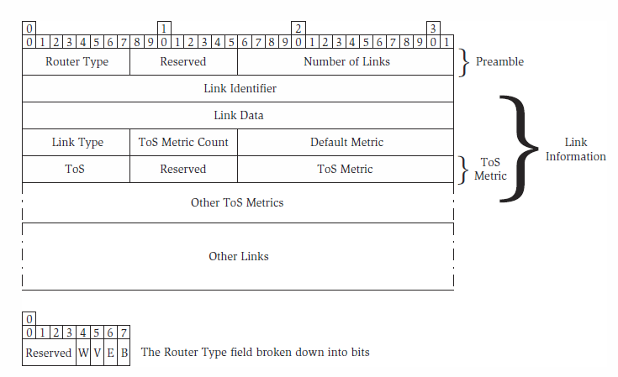
Advertising Link State
The Link State Checksum is applied to the whole LSA except for the Link State Age (which may change) and is used to verify that the contents of the LSA have not been inadvertently modified. OSPF does not use the standard IP checksum, but instead utilizes Fletcher’s checksum, which is a compromise between the CPU-intensive cyclic redundancy check and the cheap to compute but non-robust IP checksum.
Figure : The router link state advertisement.

Slide 50
Advertising Link State
Table: Router Type Bits Used in a Router Link State Advertisement in OSPF
The principal advertisement OSPF uses is the Router LSA if OSPF operates within a single area with point-to-point links, only this LSA is ever used. The Router LSA indicates the router type and then presents counted list links. The Router Type field consists of a series of bits. Each link has two fields to identify it: the Link Identifier and the Link Data. A Link Type field is provided to indicate the type of link and identify the contents of these two identity fields. The remainder of the link information provides metrics on a per ToS (Type of Service) basis. A count says how many ToS metrics are present, and a default metric is provided for all ToS values that are not listed.
Router Type Bit | Meaning
W | The router is a wildcard router for multicast support and will accept all packets.
V | The router is an end point of a virtual link that crosses an area.
E | The router is an ASBR (E is for external).
B | The router is an ABR (B is for border).

Slide 51
Advertising Link State
Table: Link Type Field in the Router Link State Advertisement Indicates the Type of the Link Being Advertised and Gives Meaning to the Link Identifier and Link Data Fields
Link Type | Meaning | Link Identifier | Link Data
1 | Point-to-Point Link | Router ID at the other end of the link. | For numbered links, the IP address of the link at the local router; for unnumbered links, the interface index at the local router.
2 | Connection to Multi-Access Network | Designated router’s IP interface address on this network. | The IP address of the link at the local router.
3 | Connection to Stub Network | Network address. | Network mask.
4 | Virtual Link | Router ID at the other end of the link. | The IP address of the link at the local router.

Slide 52
Advertising Link State
If ToS-based routing is used, a more complex routing table must be built to take into account the different metrics associated with each ToS value.
A router that sends an LSA to its neighbor wants to know that it arrived safely—if it didn’t, the sender can retransmit it. The receiver of a Link State Update message responds with one or more Link State Acknowledgement messages. These messages are simply a list of the LSA headers from the LSAs carried in the Link State Update message.

Slide 53
Multi-Access Networks and Designated Routers
Consider the network illustrated in Figure.

Slide 54
Multi-Access Networks and Designated Routers
The routers provide connectivity to other routers and networks. On such a network there are n*(n—1)/2 (that is, 15) OSPF adjacencies possible, which should require of the order of n2 (that is, 36) Hello messages to be sent out every Hello interval. This situation is improved by making use of the broadcast capabilities of the network such that each router multicasts its Hello message to the well-known address 224.0.0.5. The Hello message can list a series of neighbors, so each router on the network can tell whether the sender of the Hello has heard from it. This reduces the number of Hello messages to n (that is, 6) every Hello interval.
Every time an LSA is advertised on the network it must bounce around between the routers, repeatedly being transmitted on the same network. Since all of the routers are on the same physical network, there is no need for each router to send every advertisement to every other router, which would then send it on to every other router, resulting in (n—1) * (n—2) (that is, 20) advertisements each time a new LSA arrived at a router in the network. Instead, the routers elect a designated router to act for them—each new LSA is sent to the designated router, which then distributes the information to the other routers in the network, requiring only n (that is, 6) Link State Update messages.

Slide 55
Multi-Access Networks and Designated Routers
Figure: The full mesh of adjacencies for the routers on a multi-access network can be reduced significantly by using a designated router.

Slide 56
Multi-Access Networks and Designated Routers
The amount of traffic can be reduced still further if the designated router multicasts its advertisement rather than unicasting it to each router. The designated router has, however, introduced a single point of failure in the network. Although the routers could quickly conspire to elect a new designated router, there would be a gap during which LSAs might be lost. A common approach is to use a backup designated router to cover this potential hole. The backup designated router receives and processes the LSA, but does not send it out unless it doesn’t hear it from the designated router within five seconds (the LSA retransmission interval).
Once the designated router and backup designated router have been elected, only adjacencies to those two routers need to be maintained, requiring a total of 2n – 3 adjacencies. Database synchronization must happen on each of these adjacencies, and since the designated router cannot multicast link state update messages there are n link state messages sent for each change rather than just two.

Slide 57
OSPF Areas
Concept of areas within a single autonomous system to help break up the routing space to make it more manageable and to reduce the size of the routing tables and link state databases at individual routers. In OSPF, areas are arranged in a two-level hierarchy: area zero provides the backbone of the AS and the other areas are nested within area zero. No other nesting of areas is supported and areas are interconnected only through area zero, although any area may support connections out of the AS.
ABRs do not distribute full routing information from one area to another, but must leak enough information so that routers within an area can know that it is possible to reach addresses outside their area. Where an area has more than one ABR, the information distributed by the ABRs must allow routers within the network to select which ABR to use to route datagrams to destinations outside the area. They use the Summary LSA (type three). The network (or host) address is carried in the Link State Identifier of the LSA header, and the network mask narrows the address down to a specific subnetwork or host. A default ToS and metric must always be supplied, and more metrics may also be supplied.
ABRs can aggregate addressing information using CIDR so that they reduce the number of advertisements across the area border. A router in one area does not know the routes within another area, but it does understand the cost to reach a particular network through one ABR compared with another. when area zero distributes area one’s summary LSAs into area two, it must update the metrics to take account of the cost of traversing the backbone area.

Slide 58
Stub Areas
Small, low-powered routers are popular at the edges of the Internet and in small, company networks. These routers have neither the memory capacity nor the CPU horsepower to handle large routing tables and need to be protected from the flood of link state information inherent in being part of a large OSPF network. Isolating these routers in an OSPF area helps to reduce the information through aggregation and summary, but there still might be a very large number of networks advertised through the ABR into the area.
A stub area recognizes that routers in peripheral areas do not need to know routes to subnets in other areas—a default route to the ABR will suffice.
A stub area is configured principally at the ABR, which can absorb all summary LSAs from outside the area and generates a default route which it advertises as an LSA into the stub area. If a stub area has more than one ABR, suboptimal routes out of the area may be chosen because of the nature of the default routes used.

Slide 59
Not so Stubby Areas (NSSA)
The poetically named not so stubby area (NSSA) arose to address a specific need in a stub area. an area on the edge of an OSPF AS may be connected to an external network that is not of the OSPF area, and in fact does not run OSPF at all. This appended network might be statically configured or might run a simple routing protocol such as RIP, but the area needs to pick up the fact that the external routes exist and advertise them both into the area and into the wider OSPF network.
Figure : A possible arrangement of areas in an OSPF autonomous

Slide 60
Virtual Links
All ABRs lie on the edge of their area and connect to the backbone area, area zero. This is a fine principle that keeps the topology of the AS manageable, but it does not always fit well with the requirements of the network. For example, part of the network in the Figure is “long and thin” and needs to be split into Area 1 and Area 2, as shown, but only Area 1 has an ABR (Router Y) with a connection into Area 0.
Figure: Virtual links can be used to connect an area to the backbone and repair a problem in the backbone.

Slide 61
Virtual Links
To allow Area 2 to be split from Area 1 with a connection at Router X, Router X must be connected to the backbone by a virtual link. In the figure, the virtual link is shown by a dotted line between Router X and Router Y. It does not matter that a direct physical link does not exist between the two end points of a virtual link; the association is only logical and provides an OSPF virtual adjacency between the routers for the exchange of OSPF packets. Data packets continue to follow the data links. A virtual link is a network type as advertised by the router LSA, showing an unnumbered link between a pair of ABRs. This means that the ABRs exchange Hello messages and Link Update messages as though they were connected, but they do not advertise a physical connection so their adjacency does not find its way into the routing table.
One interesting use of virtual links is to connect two ABRs within the same area to circumvent a problem in the backbone area. This type of virtual link would be a short-lived configuration fix while the problem in the backbone was fixed. Area 3 has two ABRs connected to the backbone. If the link between Router Y and Router Z fails there is no longer any connectivity from Area 1 and Area 2 across to Area 4, but if a virtual link is installed between Area 3’s two ABRs, as shown by the dotted line, connectivity can be restored.
If OSPF cannot be run down the tunnel (perhaps because the router can only switch traffic into the tunnel, not add or terminate packets—as might be the case in an optical router), then the routers can establish a virtual adjacency.

Slide 62
Choosing to use areas
OSPF areas provide many advantages, from management and configuration simplifications to operational reductions in memory and path computation times. In addition, the use of areas increases the robustness of the routing protocol because the advertisements of link failures are dampened, being contained for the most part within the area. Similarly, routing decisions within the area are protected from strangeness outside the area since routes that are wholly within the area are always preferred by OSPF over routes that leave and reenter the area. It is also possible to use OSPF areas to keep parts of the network hidden or secret.
These benefits are offset by a decrease in performance of the SPF algorithm as information is summarized at ABRs. The discussion on the value of areas has recently received further input from an Internet Draft presented to the IETF. This draft (draft-thorup-ospf-harmful) argues that instead of solving scalability issues, areas may exacerbate them. The main thesis of the draft is that imposing an area structure on a backbone network increases the amount of information that is flooded as the network converges after a link failure. The problem arises when a network has a considerable number of ABRs. Each ABR advertises a distance metric for each router in the area—so in an area with n routers and m ABRs the number of pieces of information advertised out of the area is given as:
N_{o} =m+m(n −m)

Slide 63
Choosing to use areas
This number should be compared with the number of pieces of information advertised within an area, which is the sum of the number of links on each router. So in a network in which the area has more ABRs than the average connectivity of any router in the area, there is more information advertised into the backbone than there would have been if the two areas had been merged. There is also a suggestion that the use of areas increases the management complexity of the network because operators must place each router within an area and must configure the ABRs.

Slide 64
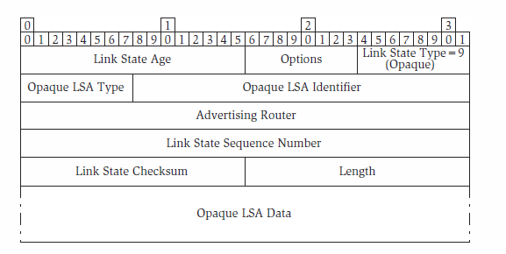
Opaque LSAs
The external LSA described in the previous section is an example of a need to distribute information that is not directly relevant to the SPF calculations performed by OSPF, but that can be carried easily by OSPF because it must be widely distributed. This concept is expanded by an extension to OSPF described in RFC 2370 and called the opaque LSA.
Figure : The OSPF opaque link state advertisement with the modified link state advertisement header.
Figure shows the opaque LSA in conjunction with the LSA header, which is slightly modified so that the Link State Identifier field is replaced by the Opaque LSA Type and Opaque LSA Identifier fields. The Opaque LSA Type field indicates to the receiver what the LSA contains and so how the information should be treated.

Slide 65
Opaque LSAs
Routers that do not understand the Opaque LSA Type ignore its contents, but still install it in their link state databases, advertise it to other routers, and generally treat the LSA as they would any other LSA.
Three Link State Types are defined to control how the opaque LSAs are propagated. This is an important feature because we cannot rely on other routers to interpret the Opaque LSA Type and make the decision based on that field. The Link State Types are 9 (do not advertise beyond the local network), 10 (do not advertise beyond the originating area), and 11 (advertise fully throughout the AS).
Opaque LSAs have come into their own recently as a way of advertising traffic engineering information (such as bandwidth usage and availability) in link state routing protocols.

Slide 66
Border Gateway Protocol 4 (BGP-4)
The Border Gateway Protocol is a path vector routing protocol. Version four of the protocol is defined in RFC 1771. BGP allows each Internet Service Provider (ISP) to operate their network as an autonomous routing cloud and only expose to the other ISPs in the reachability across the network.

Slide 67
Exterior Routing and Autonomous Systems
If we were to operate the entirety of the Internet as a single network and run one instance of an IGP throughout the whole, we would rapidly run into problems. Problems would be the size of the link state databases routers would be required to maintain for route calculation, and the rate of change of link state information as changes occurred in the network.
It is desirable to segment the Internet into separate domains and to limit the information passed between these domains. A router in ISP A that wants to route data across the network owned by ISP B to a host attached to ISP C need not be concerned with how the data is routed across ISP B’s network. It needs to know only that there is connectivity across ISP B’s network to reach the target host.
The networks managed by the ISPs are designated as autonomous systems (AS), and routing is achieved within each AS by running an Interior Gateway Protocol (IGP). The IGPs are unaware of the topology of the Internet outside of the AS, but do know how to route traffic to any node in the AS and to the nodes that lie on the edge of the AS: the autonomous system border routers (ASBRs).
The issue arises of how to route traffic between ASs. In effect, out of which ASBR should an AS route traffic for a target host that lies in some other AS? The answer is to run a routing protocol between the ASs. Such a protocol is described as an Exterior Gateway Protocol (EGP). The Border Gateway Protocol is an EGP.

Slide 68
Exterior Routing and Autonomous Systems
To some extent, each AS can be treated as a virtual node connected to other AS virtual nodes by links.
Figure : Autonomous Systems with Internet

Slide 69
Basic Messages and Formats
BGP is carried by the Transmission Control Protocol (TCP), which is a reliable transport protocol. Using this protocol means that BGP is able to concentrate on routing and leave issues of reliable delivery, retransmission, and detection of connection failure to the underlying transport protocols. consequence of using TCP is that each BGP router must be configured with the address details of its peers so that it can initiate connectivity.
Each of the five BGP messages begins with a standard header consisting of just three fields. The Marker field is a 16-byte field that is a good example of how protocols degrade and can’t dispense with obsolete fields. Originally intended to carry authentication data, each byte of the Marker field on an Open message must be set to contain 0xff, is usually set the same way on other messages. The field cannot simply be removed from the message header since deployed implementations are expecting it to be there. The Length gives the length of the entire BGP message (including the header). Length must never exceed 4096 bytes. The final field of the header indicates message type.

Slide 70
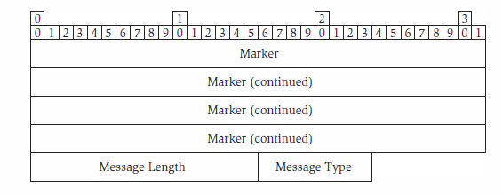
Basic Messages and Formats
Figure: The Common BGP message header.

Slide 71
Basic Messages and Formats
Table: BGP Message types.
Message type | Meaning
1 | Open: Initiates a BGP session between a pair of BGP routers. Allows routers to introduce themselves and to announce/negotiate their capabilities and the optional BGP features to be used on the session.
2 | Update: The BGP message that is used to advertise routing information from one BGP router to another.
3 | Notification: Used to report an error. Chiefly used to reject an Open message or to report a problem with an Update message.
4 | KeepAlive: Exchanged on the BGP session when there is no other traffic to allow the BGP routers to distinguish between a failed connection and a BGP peer that has nothing to say (that is, no new routes to advertise).
5 | Route-Refresh: A specific request to a BGP router for it to re-advertise all of the routes in its routing table using Update messages. This message is not defined in the original BGP-4 RFC (RFC 1771), but was added in RFC 2918.

Slide 72
Basic Messages and Formats
A router that is aware of BGP and can send and receive BGP messages is referred to as a BGP speaker. BGP is a point-to-point protocol that operates between pairs of routers— a pair of routers that exchange BGP messages are described as BGP peers. A TCP connection is an end-to-end, bidirectional transport connection between two computers that uses the TCP protocol. BGP peers communicate with each other using a TCP connection over which they establish a peering or session that is an explicit relationship between the routers for the purpose of BGP information exchange. A BGP speaker may have multiple peers at any time, each connected through a different session.
When a BGP router wishes to establish a peering with another router it opens a TCP connection using port 179. The remote router is listening on the same port. Once the connection is established the routers can exchange BGP messages. The first thing they do is establish a BGP session by exchanging Open BGP messages. If either router finds the received Open message unacceptable it responds with a Notification message and closes the TCP connection.

Slide 73
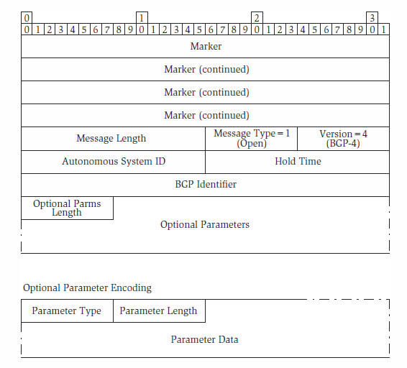
Basic Messages and Formats
Figure: The BGP open message.

Slide 74
Basic Messages and Formats
The Open message starts with a standard BGP message header and then contains five standard fields followed by optional parameters that define additional capabilities of the router. The standard fields indicate the protocol version and the AS number of the BGP speaker. The routers are configured with their own and their neighbors’ AS numbers. This allows the routers to perform an additional sanity check when they first set up a new session.
The standard fields also contain the Hold Time expressed in seconds. This is the time that the BGP speaker will wait before declaring the session dead. When there are no other messages to send, a BGP speaker sends a KeepAlive message approximately once every third of the hold time. The Hold Time is negotiated between the BGP peers using the Open message—the value used by both peers on a session is the lesser of the two values exchanged.
The next field in the Open message is the BGP Identifier of the sender of the message. This value is required to be unique and to be the same for each session in which the speaker participates, but it has no particular semantics. the BGP Identifier is usually set to one of the loopback addresses.

Slide 75
Basic Messages and Formats
The final field gives the length of the options that follow the optional parameters on a BGP Open message are encoded in type-length variable (TLV) format. A sequence of TLVs are present up to the length indicated by the Optional Parameters Length field. The Type field identifies the optional parameter and the Length gives the subsequent parameter data in bytes (excluding the Type and Length fields). Using this format, parameters may themselves be constructed from sub parameters that are also expressed as TLVs.
Table: The BGP Capability Codes Used in the Capabilities Optional Parameter on a BGP Open Message
Capability code | Meaning
0 | Reserved.
1 | Multiprotocol Extensions (see RFC 2858). Used to show that the BGP speaker can distribute routes for routing tables other than IPv4. This is particularly useful for IPv6, but is also used in MPLS to distribute labels in association with routes.
2 | Route Refresh Capability (see RFC 2918). The BGP speaker is capable of handling and responding to the Route Refresh message.
5–63 | Unassigned.

Slide 76
Basic Messages and Formats
Capability code | Meaning
64 | Graceful Restart Capability. The BGP speaker supports a graceful restart procedure currently under development that allows the router to restart and reestablish sessions with its peers without discarding forwarding state that may be installed in hardware modules.
65 | Support for 4-byte AS number capability. The sender of the Open message supports an extension to allow AS numbers to be expressed in 4 bytes rather than the current 2-byte limit.
68–127 | Unassigned.
128–255 | Vendor Specific. Available for vendors to define their own capabilities.

Slide 77
Basic Messages and Formats
The Multiprotocol Capability is used to show that the BGP speaker can handle routes for a variety of protocols and uses. The protocols are expressed using an Address Family Indicator (AFI). An AFI of 1 indicates IPv4 and an AFI of 2 shows support for IPv6. A further code, the Subsequent Address Family Identifier (SAFI), qualifies the AFI by showing to what use the routing information for the AFI can be put by the BGP speaker.
Table: BGP Notification Message Error Codes and Sub codes.
Error Code | Sub-code | Meaning
1 |  | Message Header Error. There is an error with the header of a received BGP message. The sub-code qualifies the error.
 | 1 | Connection Not Synchronized. The marker field contains an unexpected value. Probably never used.
 | 2 | Bad Message Length. The message length is less that 19 or greater than 4096 bytes, or the message is too short or too long for the specific message type. The error data is used to return a 2-byte field containing the bad length value.
 | 3 | Bad Message Type. The message type value is not recognized. The error data is used to return a single-byte field containing the bad message type value.

Slide 78
Basic Messages and Formats
Error Code | Sub-code | Meaning
2 |  | Open Message Error. There is an error with an Open message that is not a message header problem. The sub-code qualifies the error.
 | 1 | Unsupported Version Number. The Open message contains an unsupported protocol version number. The error data is used to return a 2-byte field containing the largest supported version number.
 | 2 | Bad Peer AS. The Open message contains an unacceptable AS number. This is probably because the receiving BGP peer has been configured to expect a different AS number from the one supplied.
 | 3 | Bad BGP Identifier. RFC 1771 says that this error code is used if the BGP identifier in the Open message is syntactically incorrect and that the BGP identifier is not a valid IP address. This apparently contradicts the definition of BGP identifier which may be any unique 32-bit number. Note also that this sub-code would be used if the BGP identifier was not as expected through configuration, or matched the local identifier.
 | 4 | Unsupported Optional Parameter. One of the optional parameters is not recognized or is unsupported. Although RFC 1771 says nothing on the subject, the error data usually contains an entire copy of the unsupported optional parameter TLV.

Slide 79
Basic Messages and Formats
Error Code | Sub-code | Meaning
 | 5 | Authentication Failure. Unused since BGP authentication is not used.
 | 6 | Unacceptable Hold Time. Used to reject hold time values of 1 or 2 seconds, which are illegal. May also be used to reject a timer value (especially zero) that is unacceptable to the receiver.
 | 7 | Unsupported Capability. One of the capability sub parameters of the capabilities optional parameter is unrecognized or unsupported. The error data field contains the entire sub parameter TLV that is in question, and may contain a sequence of unsupported sub parameters.
3 |  | Update Message Error. There is an error with an Update message that is not a message header problem. The sub-code qualifies the error.
 | 1 | Malformed Attribute List. Parsing of the Withdrawn Routes or Path Attributes has failed because of length, construction, or syntax problems. This includes the presence of multiple copies of a single attribute.
 | 2 | Unrecognized Well-known Attribute. An unexpected, unsupported, or unrecognized Path Attribute was encountered. The error data field contains the whole erroneous Attribute TLV.

Slide 80
Basic Messages and Formats
Error Code | Sub-code | Meaning
 | 3 | Missing Well-known Attribute. A mandatory Path Attribute is missing. The error data contains a single byte field showing the Path Attribute Code of the missing attribute.
 | 4 | Attribute Flags Error. Some Path Attribute is present with flag settings that are incompatible with the attribute itself. The error data field contains the whole erroneous Attribute TLV.
 | 5 | Attribute Length Error. The length of a Path Attribute is not as expected from its type. The error data field contains the whole erroneous Attribute TLV.
 | 6 | Invalid Origin Attribute. The Origin Attribute contains an undefined value. The error data field contains the whole erroneous Attribute TLV.
 | 7 | AS Routing Loop. This error is not described in RFC 1771. In general, routes that contain AS routing loops are simply discarded by the receiver, but this sub-code can be used to report the problem to the sender.
 | 8 | Invalid Next Hop Attribute. The Next Hop Attribute contains a value that is not syntactically correct. Syntactical correctness means that the attribute contains a valid IPv4 address. The error data field contains the whole erroneous Attribute TLV.

Slide 81
Basic Messages and Formats
Error Code | Sub-code | Meaning
 | 8 (contd) | Note that if the Next Hop is semantically incorrect (that is, contains a valid IPv4 address that does not share a common subnet with the receiver, or is equal to one of the addresses of the receiver itself, no Notification message is sent and the advertised route is ignored.
 | 9 | Optional Attribute Error. An optional attribute is recognized but fails to parse or contains an unsupported value. The erroneous optional attribute is skipped, but the remainder of the message is processed. The error data field contains the whole erroneous Optional Attribute TLV.
 | 10 | Invalid Network Field. The NLRI value in the MP Reach NLRI Attribute or the MP Un-reach NLRI Attribute is syntactically incorrect.
 | 11 | Malformed AS Path. The AS Path Attribute is malformed or syntactically incorrect.

Slide 82
Basic Messages and Formats
Error Code | Sub-code | Meaning
4 |  | Hold Timer Expired. The hold timer has expired without the receipt of an action message or a KeepAlive message. The sender closes the TCP connection immediately after the message has been sent.
5 |  | Finite State Machine Error. This error may represent an internal implementation issue or the receipt of an unexpected message (for example, an Update message received before the Open message exchange has completed). The Notification can only tell the receiver that something may have gone horribly wrong—nothing can be done except holding on and hoping for the best or closing the session and starting again.
6 |  | Cease. The sender wishes to close the BGP session. The TCP connection would normally (although not necessarily) be closed after this message has been sent. Note that this error code must not be used in place of a more helpful error code when a problem has been detected.

Slide 83
Basic Messages and Formats
The Route Refresh message can be used by a BGP speaker to request a complete and immediate update of all the routes known by its peer. This enables it to get its routing table up-to-date quickly. It is particularly useful for an implementation that has had to jettison its routing table because of an error, but doesn’t want to close and reopen the session.
The Route Refresh message was not present in the original BGP specification, but was added by RFC 2918. For backwards compatibility, it must be used only if the receiver indicated support for the message by including a Route Refresh Capability sub-parameter to the Capabilities Optional Parameter on its Open message. The sender of the Route Refresh can restrict the routing tables it wants to see by setting an AFI and SAFI as previously defined for the Multiprotocol Capability optional sub-parameter.
The meat of BGP comes with the Update message. This is used to distribute routes between BGP peers, and to withdraw routes that have previously been advertised. After the common message header, the Update message consists of the three distinct blocks of information : The Withdrawn Routes, the Path Attributes, and the advertised routes known as the Network Layer Reachability Information (NLRI).

Slide 84
Basic Messages and Formats
IPv4 routes that are being withdrawn are listed in the Withdrawn Routes section of the message. This section begins with a 2-byte length field that is always present and indicates how many bytes of withdrawn route information follow. Each withdrawn route is expressed as a single byte that encodes the prefix length, followed by just enough bytes to carry the prefix itself.
The next block of data in the Update message contains parameters called Path Attributes that apply to all of the routes that are being added by this advertisement. The Path Attributes are prefixed by a mandatory length field that says how many bytes of Path Attribute information follow, but the routes to which the attributes apply do not qualify for a length field since their length can be deduced from the overall message length and the two other length fields. The Path Attributes field is constructed of a series of attributes of a standard format (assuming the length is not set to zero). There are two variants of the format, allowing an attribute to be encoded with a 1- or 2-byte length field. The format of each attribute is Flags-Type Length-Data where the initial flags field includes a flag (the fourth bit—that is, bit 3) that indicates whether the long or short length field is in use.

Slide 85
Basic Messages and Formats
There are three other flags defined in the flags field of the Path Attributes. The O-flag describes whether the attribute is optional (set to 1) and therefore may be unsupported by the receiver, or well known and must be supported by the receiver (set to zero). The T-flag describes how the receiver must redistribute the Path Attribute if it forwards the route to another BGP peer—if the attribute is transitive the bit is set to 1 and the attribute must be passed on, but if the bit is set to zero the attribute is not passed on. All well-known attributes must have the transitive bit set. The final bit, the P-flag, indicates whether the information in an optional transitive attribute was added at the source of the announcement of the prefixes or whether it is partial was added at a later stage.

Slide 86
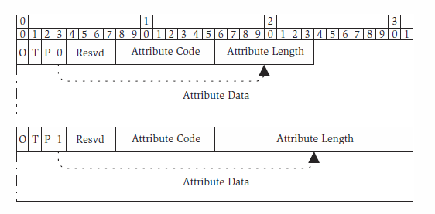
Basic Messages and Formats
Figure: BGP Path Attributes are encoded with 1- or 2-byte length fields according to the setting of bit 4 of the flags field.

Slide 87
Basic Messages and Formats
Type | O-Bit | Mandatory | T-Bit | Meaning
1 | 0 | Yes | 1 | Origin. This attribute describes how the routes being advertised were learned by (or injected into) BGP. Three values are used, encoded as a single byte of data: 1 indicates that the route was learned from an IGP (such as OSPF), 2 shows that the route came from the EGP (that is, the protocol called EGP), and 3 indicates that it used some other means. Routes that are statically configured are indicated using the value 3.
2 | 0 | Yes | 1 | AS Path. This provides a list of autonomous systems through which the route has been advertised to reach the current node. The AS are represented by their AS numbers which are each 2-byte numbers. The list is well ordered, starting with the first AS in the progression. The AS Path needs to support the concept of a sequence and a set. This is handled in BGP by encoding the AS Path as a series of path segments. Each segment is a sequence or a set and is formatted as 1 byte type (type 1 for a sequence, type 2 for a set), a 1-byte length field indicating how many bytes of value follow, and the value itself, which is constructed as a series of AS numbers. Note that this attribute is not a candidate for the P-bit since the attribute is well known and transitive.

Slide 88
Basic Messages and Formats
Type | O-Bit | Mandatory | T-Bit | Meaning
3 | 0 | Yes | 0 | Next Hop. This is the IP address of the node to which the receiver of the advertisement should forward traffic that matches the routes. In the usual case, the address is an address of the BGP speaker advertising the route, but this does not need to be the case if one speaker advertises routes on behalf of another node—perhaps not all exit points from an AS are BGP enabled. The value field carries the 4-byte IP address.
4 | 0 | No | 0 | Multi-Exit Discriminator. This attribute is used to help choose between multiple parallel connections between a pair of AS. Two destinations may be reachable over both of the inter-AS connections, but one connection should be preferred for each of the destinations . The Multi-Exit Discriminator is advertised out of the AS to enable routing decisions to be made by external routers. The advertising AS can set a metric or cost for each of the routes so that the receiving AS can make a choice. The value of the metric may be derived from the cost of the IGP path across the advertising AS. The value field of this attribute is a 4-byte integer.

Slide 89
Basic Messages and Formats
Type | O-Bit | Mandatory | T-Bit | Meaning
5 | 0 | No | 0 | Local Preference. The Multi-Exit Discriminator helps external routers choose from parallel paths between a pair of AS. The Local Preference attribute helps routers choose routes within their own networks to select from parallel paths that involve multiple AS such as in the network. This attribute has a 4-byte attribute value that expresses the advertiser’s preference for a route, with the higher value indicating a higher preference. Note that Local Preference can also be used in place of the Multi-Exit Discriminator, but has a subtly different meaning. Local Preference provides additional guidance to the nodes choosing routes, whereas the Multi-Exit Discriminator is closer to an instruction.
6 | 0 | No | 0 | Atomic Aggregate. If an advertising router wishes to indicate that a route must not be de-aggregated it attaches the Atomic Aggregate attribute. This prevents nodes further upstream from splitting the prefix into several longer prefixes routed in different ways. The Atomic Aggregate attribute is just a flag and carries no data, and so has a length of zero.
7 | 0 | No | 1 | Aggregator. This attribute allows a node to indicate that it is responsible for address aggregation within the advertised route. Note that if successive aggregation is performed this attribute may be confusing or misleading. The Aggregator attribute is encoded as a 2-byte AS number followed by a 4-byte IPv4 address to uniquely identify the aggregator node in the context of the whole network.

Slide 90
Basic Messages and Formats
Type | O-Bit | Mandatory | T-Bit | Meaning
19–254 |  |  |  | Unassigned.
255 |  |  |  | Reserved for development.

Slide 91
Basic Messages and Formats
The term multihoming is used to describe multiple connections to or from a host or an autonomous system. A host is described as multihomed if it is connected to two networks. An AS is described as multihomed if it has more than one connection to one or more other AS. The Figure below shows how the Multi-Exit Discriminator attribute may be used to help routers in one AS distinguish between a pair of parallel routes across another AS.

Slide 92
Basic Messages and Formats
Routers X and Y assign metrics from the IGP (counting one for each hop) and signal these using the Multi-Exit Discriminator attribute. Now (all other things being equal) AS A knows that to reach 172.168.10.0/28 it is better to use the link to Router X, but for 172.168.10.16/28 it should use Router Y.
Figure: The local preference attribute is used to help choose between parallel paths in more complex networks

Slide 93
Communities
A community is simply a set of routes that are treated administratively in the same way. This property is sometimes referred to as route coloring. The treatment of each community is a local (AS-wide) configuration issue, and when communities are exposed to other ASs a degree of configuration is required if the other ASs are to make full use of the information since the community numbers do not have the same meaning in different AS.
Three well-known community identifiers apply to all ASs. The value 0xffffff01 indicates that the route must not be exported beyond the AS. 0xffffff02 is used to indicate that the route must not be advertised beyond the receiving router. 0xffffff03 describes routes that may be advertised, but only within the confines of the current AS confederation.
The community attribute: Each community identifier is a 4-byte integer and is conventionally broken up into 2 bytes of AS number and 2 bytes indicating the community within the AS. The Community attribute has type 8, it is optional (O-bit set to 1) and transitory (T-bit set to 1).

Slide 94
Multiprotocol Support
To be fully useful within the Internet, BGP must also support IPv6 addressing there are backwards compatibility issues with simply allowing the NLRI to contain 16-byte prefixes since deployed implementations expect to find only IPv4 prefixes in that field.
The solution, described in RFC 2283, is to introduce two new path attributes. The Multiprotocol Reach NLRI and Multiprotocol Un-reach NLRI attributes carry conceptually the same information as the NLRI and Withdrawn Routes fields, respectively, but these attributes define the address space to which they refer before listing a series of routes or addresses.
The Multiprotocol Reach NLRI has type 14 and the Multiprotocol Un reach NLRI has type 15. Both attributes are optional and nontransitive. The Multiprotocol Reach NLRI encodes the AFI and SAFI of the subsequent addresses using the same values used in the Capabilities sub parameter .Each attribute contains the Next Hop address one or more Subnetwork Point of Attachment (SNPA) addresses to indicate connectivity to the next hop, and one or more NLRIs.
Route withdrawal works in a similar way. Each entry in the Multiprotocol Un-reach NLRI path attribute consists of an AFI, SAFI, and a list of prefix lengths and prefixes, each encoded as before. The multiprotocol extensions to BGP are now used to associate MPLS label with routes that are distributed across an AS.

Slide 95
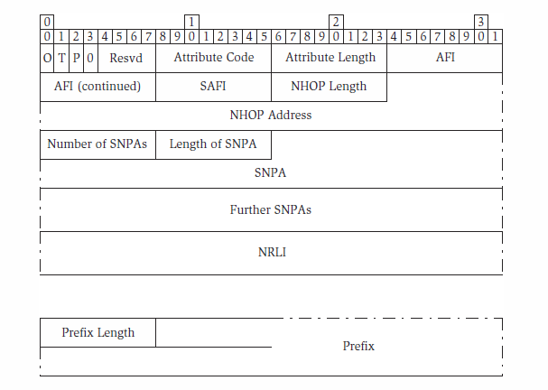
Multiprotocol Support
Figure: The BGP Multiprotocol Reach NLRI Path Attribute carries information about one or more non-IPv4 routes of the same type.

Slide 96
Dampening Route Flap
When a link or node in the BGP network fails, the neighboring peers withdraw the routes that used the failed resource. Interface cards and links are notorious for a type of error called flapping, in which the link status goes up and down repeatedly in a relatively short time. Each time the link comes back, BGP sessions are reestablished and routes are redistributed only to have the link fail again and the routes be withdrawn. the associated route flap in the BGP routers’ routing tables causes traffic to be repetitively switched from one route to another. This is highly undesirable.
Route flap is circumvented by an operational extension to BGP called route flap dampening. When a route is withdrawn it is held by a router in a withdrawn routes list for a period of time. If the route is re-advertised to the router while the route is still in the withdrawn list it is held and not distributed further until a second period of time has elapsed to prove that the route is stable.

Slide 97
Interior BGP
BGP it can also be used as an Interior Gateway Protocol for route exchange between routers within an autonomous system or for transporting exterior routes across an AS to advertise them into the next AS. This use has clear benefits because it significantly simplifies the interactions between the IGP and BGP and removes any requirement for the IGP to transport information across the AS on behalf of BGP. Run as an IGP, BGP is referred to as Interior BGP (I-BGP).
Figure shows five autonomous systems joined together to form a larger network. AS D and AS E are able to communicate directly and would use BGP (that is, E-BGP) to exchange routing information, but traffic to and from AS A and B must traverse AS C. Each of the AS runs an IGP internally, but this only provides routing information within the AS. The question must be asked: How does a router at the core of an AS know how to forward packets out of the AS?

Slide 98
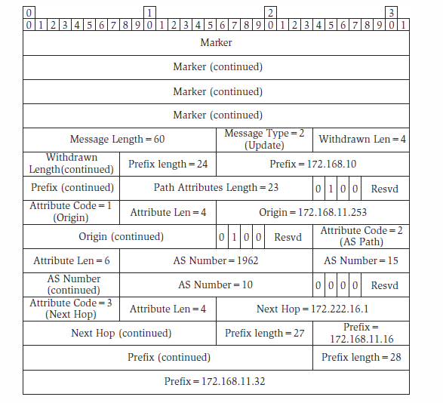
Interior BGP
Figure: An example BGP Update message

Slide 99
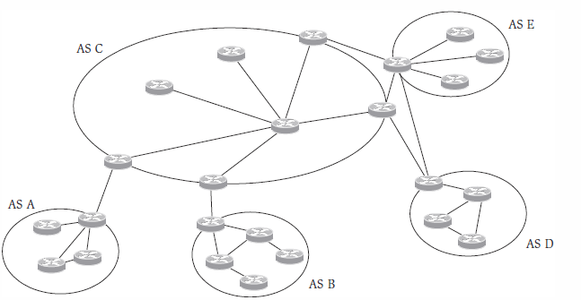
Interior BGP
Figure: A transit autonomous system links together several other autonomous systems.

Slide 100
Interior BGP
Routers in AS C the choice is more difficult. Routers that only have one other adjacent router can handle the problem using default routes, but routers with more than one adjacent router (transit routers) must make an informed routing decision.
one option would clearly be for the ASBRs to leak the external routing information to their IGPs and allow the information to be distributed across their network. But this is exactly what ASs were created to avoid! The solution is to use BGP to distribute the external routing information. This information is needed not just at the ASBRs, but at every transit router in the AS.
There are some important differences between the form of BGP run across AS borders and that run within an AS. I-BGP does not prepend the AS number to the routes. This might create a risk of looping within an AS, but since there is a full mesh of I-BGP sessions, each router is fully aware of all the BGP speakers in the AS and there is no problem with loops. There is a basic rule that states that I-BGP peers must not re-advertise routes within the AS that they learned from other peers within the AS. This corresponds to n(n – 1)/2 sessions where there are n BGP speakers. Clearly, as the number of BGP speakers grows, this may result in an unmanageably large number of sessions as each BGP speaker must maintain n – 1 sessions. I-BGP presents a serious scaling issue as the size of an AS grows.

Slide 101
Scaling I-BGP: Route Reflection
Route reflection is achieved by imposing a client–server relationship between BGP speakers within an AS. Route reflector clients are implemented with no change from the original specification, but with a configuration change so that each client need only attach to a single route reflector. The client depends on the route reflector to re-advertise its routes to the rest of the AS, and requires the route reflector to deliver to it all of the routes from the AS. The route reflectors themselves break the I-BGP rules and do redistribute routes within the AS—this redistribution is limited to the server–client relationship so that each route reflector only redistributes to other route reflectors those routes learned from a client, while it also redistributes all routes, however learned, to each client. The route reflectors must be arranged in a full mesh.
Note that the connectivity shown in a route reflection diagram does not refer to the connectivity between the routers—they may be connected together in any arbitrary way. The route reflector diagrams show only the BGP sessions between routers.
Route reflection opens up a problem that the original I-BGP rules were designed to eradicate. Now that routes can be re-advertised within the AS, there is a risk of routing loops. Two new path attributes are introduced in RFC 2796 to enable the BGP routers to control this issue. The Originator ID path attribute (type 9, optional, nontransitive) carries the 4-byte router ID of the router that originated the route. The attribute is not added by a reflector client (since reflector clients do not understand route reflection extensions), but is inserted by the route reflector itself

Slide 102
Scaling I-BGP: Route Reflection
Additional rules are:
The Originator ID is not forwarded out of the AS.
A route reflector must not replace an Originator ID if one already exists.
A route reflector never advertises a route back to the router indicated by the Originator ID.
When a route is distributed into a cluster, the receiving router checks to see whether the route has been advertised into the cluster before and drops it if it has. Note that the normal case is that a cluster contains just one route reflector, in which case the cluster ID is set to the router’s router ID.

Slide 103
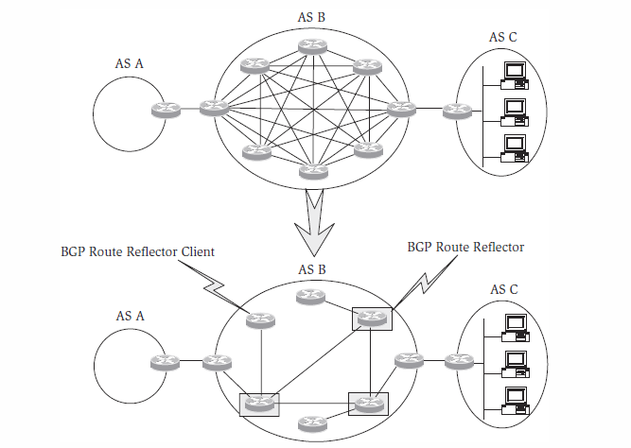
Scaling I-BGP: Route Reflection
Figure: Route reflection reduces the full-mesh connectivity problem by imposing a hierarchy on the BGP speakers within an AS.

Slide 104
Scaling I-BGP: AS Confederations
An alternative approach to solving the I-BGP scaling problems is to divide the AS into sub-ASs and group these sub-ASs together as a confederation. The confederation formed in this way is the same size and contains exactly the same routers as the original AS, but is administratively broken into sub-AS, each of which acts as an AS in its own right. The confederation continues to represent itself externally as a single AS.
once the large AS has been broken up, the rules about distributing routes within the AS no longer apply and all of the usual inter-AS features of E-BGP, including route exchange, can be applied to the sub-AS. Figure shows how an AS might be managed as a confederacy of sub-AS: AS A, B, and C are the top-level autonomous systems, but AS B is actually a confederacy of AS W, X, Y, and Z. AS A and AS C run E-BGP sessions with AS B. The sessions within AS B are broken into two groups: those within a sub-AS (such as AS W) are still called I-BGP sessions, but those between sub-ASs are called EI-BGP sessions.

Slide 105
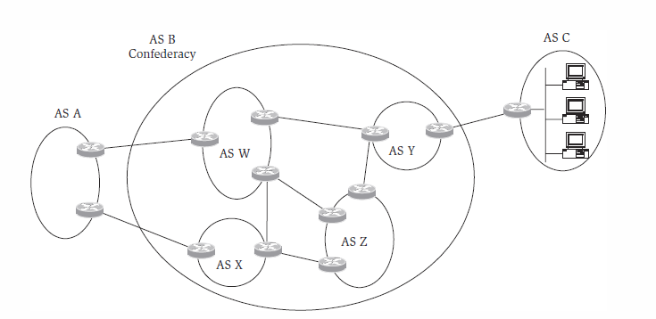
Scaling I-BGP: AS Confederations
Figure : A large AS can be managed as a confederacy of sub-AS.

Slide 106
Choosing to Use BGP
BGP-4 is fast becoming the common choice because of its widespread availability on routers, the extensive deployment experience that has been gained within the Internet, and the way it opens up future seamless connectivity to the Internet should it be required.
Within an AS, or rather, across the AS, it is not necessary to run I-BGP to distribute routes between ASBRs; any interior routing protocol could be used, but there can be disastrous consequences for the IGP if this is not managed very carefully. This makes I-BGP a sensible choice.

